Slide 1
Computer Organization and Design
Instructions: Language of the Computer

Slide 2
Instruction Set
§2.1 Introduction
The repertoire of instructions of a computer
Different computers have different instruction sets
But with many aspects in common
Early computers had very simple instruction sets
Simplified implementation
Many modern computers also have simple instruction sets

Slide 3
The MIPS Instruction Set
Used as the example throughout the course
Stanford MIPS commercialized by MIPS Technologies (www.mips.com)
Large share of embedded core market
Applications in smartphones, tablets, consumer electronics, network/storage equipment, cameras, printers, …

Slide 4
Arithmetic Operations
Add and subtract, three operands
Two sources and one destination
add a, b, c # a gets b + c
All arithmetic operations have this form
Design Principle 1: Simplicity favours regularity
Regularity makes implementation simpler
Simplicity enables higher performance at lower cost
§2.2 Operations of the Computer Hardware

Slide 5
Arithmetic Example
C code:
f = (g + h) - (i + j);
Compiled MIPS code:
add t0, g, h # temp t0 = g + h add t1, i, j # temp t1 = i + j sub f, t0, t1 # f = t0 - t1

Slide 6
Register Operands
Arithmetic instructions use register operands
MIPS has a 32 × 32-bit register file
Use for frequently accessed data
Numbered 0 to 31
32-bit data called a “word”
Assembler names
$t0, $t1, …, $t9 for temporary values
$s0, $s1, …, $s7 for saved variables
Design Principle 2: Smaller is faster
Reason for small register file
c.f. main memory: millions of locations
§2.3 Operands of the Computer Hardware

Slide 7
Register Operand Example
C code:
f = (g + h) - (i + j);
f, …, j in $s0, …, $s4
Compiled MIPS code:
add $t0, $s1, $s2 add $t1, $s3, $s4 sub $s0, $t0, $t1

Slide 8
Memory Operands
Main memory used for composite data
Arrays, structures, dynamic data, …
Only a small amount of data can fit in registers
To apply arithmetic operations
Load values from memory into registers
Store result from register to memory
Memory is byte addressed
Each address identifies an 8-bit byte
Words are aligned in memory
Address must be a multiple of 4
MIPS is Big Endian
Most-significant byte at least address of a word
c.f. Little Endian: least-significant byte at least address
Notes:
c.f. confer, compare
对齐方式就是从内存与寄存器间数据交换时数据读写顺序

Slide 9
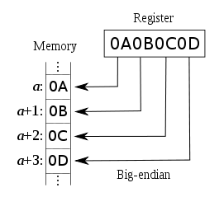
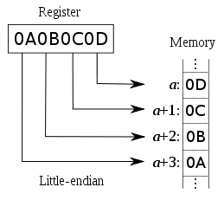
Big vs. Little Endian
Big Endian: leftmost byte is word address
IBM 360/370, Motorola 68k, MIPS, Sparc, HP PA
Little Endian: rightmost byte is word address
Intel 80x86, DEC Vax, DEC Alpha (Windows NT)
Notes:
这对于常数的处理非常重要，需要编译器的支持来完成。为什么C语言的编译器在编译时需要选择不同的目标CPU
小端对齐 ： 低位在低字节，高位在高字节。
大端对齐： 与小端对齐相反。

Slide 10
Memory Operand Example 1
C code:
g = h + A[8];
g in $s1, h in $s2, base address of A in $s3
Compiled MIPS code:
Index 8 requires offset of 32
4 bytes per word
lw $t0, 32($s3) # load word add $s1, $s2, $t0
offset
base register

Slide 11
Memory Operand Example 2
C code:
A[12] = h + A[8];
h in $s2, base address of A in $s3
Compiled MIPS code:
Index 8 requires offset of 32
lw $t0, 32($s3) # load word add $t0, $s2, $t0 sw $t0, 48($s3) # store word

Slide 12
Registers vs. Memory
Registers are faster to access than memory
Operating on memory data requires loads and stores
More instructions to be executed
Compilers use registers for variables as much as possible
Only “spill” to memory for less frequently used variables
Register optimization is important!
Notes:
寄存器与内存之间的比较
编译器尽可能使用寄存器变量， 尽量将使用不频发的数据 放置到内存中
寄存器优化就十分重要。（寄存器有限的，因此将程序中的哪些变量分配成寄存器呢？这是一个分配和调度的问题）

Slide 13
Immediate Operands
Constant data specified in an instruction
addi $s3, $s3, 4
No subtract immediate instruction
Just use a negative constant
addi $s2, $s1, -1
Design Principle 3: Make the common case fast
Small constants are common
Immediate operand avoids a load instruction
Notes:
立即数操作数据，立即数操作数可以避免一次数据加载指令 lw
哪些是立即数呢？循环变量、边界值等

Slide 14
Number types
Integer numbers, unsigned
Address calculations
Numbers that can only be positive
Signed numbers
Positive
Negative
Floating point numbers
numeric calculations
Different grades of precision
Singe precision (IEEE 754)
Double precision (IEEE 754)
Quadruple precision
Notes:
前面我们介绍了计算机中的三种操作对象 寄存器、内存、立即数
那么计算机中的指令能够处理哪些数据类型呢？ 计算机中如何来表示这些数据呢？

Slide 15
Number formats
Sign and magnitude
2's complement
1's complement
similar to 2's complement, + 0 & - 0
Biased notation
1000 0000 = minimal negative value(-2⁷)
0111 1111 = maximal positive value (2⁷-1)
Representation
Binary
Decimal
Hexadecimal
Notes:
1‘s complement , 原码， 2’s complement 补码

Slide 16
The Constant Zero
MIPS register 0 ($zero) is the constant 0
Cannot be overwritten
Useful for common operations
E.g., move between registers
add $t2, $s1, $zero
Notes:
零 在MIPS中如何表示和存储
零号寄存器可以用来完成寄存器之间的传输和赋值操作

Slide 17
Unsigned Binary Integers
Given an n-bit number
§2.4 Signed and Unsigned Numbers
Range: 0 to +2^{n} – 1
Example
0000 0000 0000 0000 0000 0000 0000 1011₂ = 0 + … + 1×2³ + 0×2² +1×2¹ +1×2⁰ = 0 + … + 8 + 0 + 2 + 1 = 11₁₀
Using 32 bits
0 to +4,294,967,295
Notes:
有符号数和无符号数

Slide 18
Signed number representation
First idea:
Positive and negative numbers
Take one bit (e.g. 31) as the sign bit
Problem
0 0000000 = 0 positive zero!
1 0000000 = 0 negative zero!
Each comparison to 0 requires two steps
1's complement
2's complement

Slide 19
2s-Complement Signed Integers
Given an n-bit number
Range: –2^{n – 1} to +2^{n – 1} – 1
Example
1111 1111 1111 1111 1111 1111 1111 1100₂ = –1×2³¹ + 1×2³⁰ + … + 1×2² +0×2¹ +0×2⁰ = –2,147,483,648 + 2,147,483,644 = –4₁₀
Using 32 bits
–2,147,483,648 to +2,147,483,647

Slide 20
2s-Complement Signed Integers
Bit 31 is sign bit
1 for negative numbers
0 for non-negative numbers
–(–2^{n – 1}) can’t be represented
Non-negative numbers have the same unsigned and 2s-complement representation
Some specific numbers
0: 0000 0000 … 0000
–1: 1111 1111 … 1111
Most-negative: 1000 0000 … 0000
Most-positive: 0111 1111 … 1111
By default, all data in MIPS is a signed integer
add vs. addu

Slide 21
Signed Negation
Complement and add 1
Complement means 1 → 0, 0 → 1
Example: negate +2
+2 = 0000 0000 … 0010₂
–2 = 1111 1111 … 1101₂ + 1 = 1111 1111 … 1110₂

Slide 22
Sign Extension
How to represent a number using more bits?
e.g. 16 bit number as a 32 bit number
Must preserve the numeric value
Replicate the sign bit to the left
c.f. unsigned values: extend with 0s
Examples: 8-bit to 16-bit
+2: 0000 0010 => 0000 0000 0000 0010
–2: 1111 1110 => 1111 1111 1111 1110
In MIPS instruction set
addi: extend immediate value
lb, lh: extend loaded byte/halfword
beq, bne: extend the displacement

Slide 23
Representing Instructions
Instructions are encoded in binary
Called machine code
MIPS instructions
Encoded as 32-bit instruction words
Small number of formats encoding operation code (opcode), register numbers, …
Regularity!
Register numbers
$t0 – $t7 are reg’s 8 – 15
$t8 – $t9 are reg’s 24 – 25
$s0 – $s7 are reg’s 16 – 23
§2.5 Representing Instructions in the Computer
Notes:
以上介绍了 MIPS指令集结构中整数的表示问题。那么我们常用的小数如何表示呢？ 我们在后面的内容中继续学习
那么指令如何表示呢？

Slide 24
MIPS-32 ISA
Registers
Instruction Categories
Computational
Load/Store
Jump and Branch
Floating Point
--coprocessor
Memory Management
Special
R0 - R31
PC
HI
LO
Instruction Formats: all 32 bits wide
op
rs
rt
rd
sa
funct
R format
op
rs
rt
immediate
I format
op
jump target
J format
Notes:
我们可以看到 MIPS指令集分为如下6类指令
其中所有的指令的格式都为32位的定长指令，其构成可以分为如下三种格式的指令R\I\J

Slide 25
MIPS R-format Instructions
op
rs
rt
rd
shamt
funct
6 bits
5 bits
5 bits
5 bits
5 bits
6 bits
Instruction fields
op: operation code (opcode)
rs: first source register number
rt: second source register number
rd: destination register number
shamt: shift amount (00000 for now)
funct: function code (extends opcode)
Notes:
首先我们来看一下R型的指令，以及指令中每个字段（域）的含义

Slide 26
R-format Example
op
rs
rt
rd
shamt
funct
6 bits
5 bits
5 bits
5 bits
5 bits
6 bits
add $t0, $s1, $s2
special
$s1
$s2
$t0
0
add
0
17
18
8
0
32
000000
10001
10010
01000
00000
100000
00000010001100100100000000100000₂ = 02324020₁₆

Slide 27
Hexadecimal
Base 16
Compact representation of bit strings
4 bits per hex digit
0 | 0000 | 4 | 0100 | 8 | 1000 | c | 1100
1 | 0001 | 5 | 0101 | 9 | 1001 | d | 1101
2 | 0010 | 6 | 0110 | a | 1010 | e | 1110
3 | 0011 | 7 | 0111 | b | 1011 | f | 1111
Example: eca8 6420
1110 1100 1010 1000 0110 0100 0010 0000
Notes:
16进制数，为了更好观察指令的结果

Slide 28
MIPS I-format Instructions
op
rs
rt
constant or address
6 bits
5 bits
5 bits
16 bits
Immediate arithmetic and load/store instructions
rt: destination or source register number
Constant: –2¹⁵ to +2¹⁵ – 1
Address: offset added to base address in rs
Design Principle 4: Good design demands good compromises
Different formats complicate decoding, but allow 32-bit instructions uniformly
Keep formats as similar as possible
Notes:
I 型的指令

Slide 29
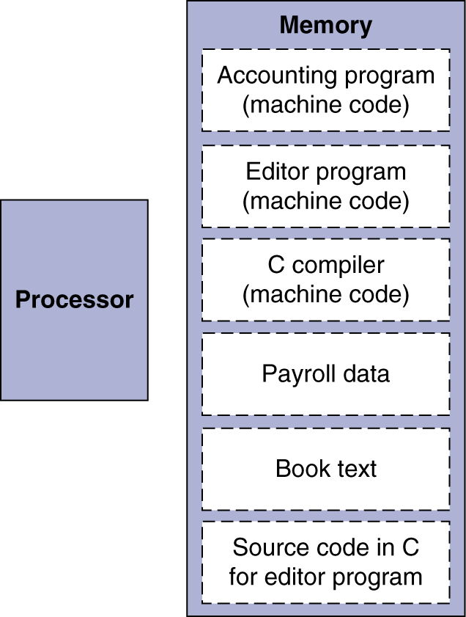
Two Key Principles of Computer Design
Instructions are represented as numbers and, as such, are indistinguishable from data
Programs are stored in alterable memory (that can be read or written to) just like data
The BIG Picture
Stored-program concept
Programs can be shipped as files of binary numbers – binary compatibility
Computers can inherit ready-made software provided they are compatible with an existing ISA – leads industry to align around a small number of ISAs
Notes:
我们了解了指令的格式，那么由指令组成的程序是如何设计和工作呢？
右边的图示了程序和数据在内存中的分布情况，我们可以观察到：
冯诺依曼计算机工作原理是存储程序的工作方式，该方式遵循以下2原则： 程序和数据都都表示为数字（二进制 0101），程序是可以数据一样读写
软件兼容性，导致工业界围绕着少量的ISA架构的联盟

Slide 30
Logical Operations
Instructions for bitwise manipulation
§2.6 Logical Operations
Operation | C | Java | MIPS
Shift left | << | << | sll
Shift right | >> | >>> | srl
Bitwise AND | & | & | and, andi
Bitwise OR | | | | | or, ori
Bitwise NOT | ~ | ~ | nor
Useful for extracting and inserting groups of bits in a word
Notes:
下面我们介绍最常见的几类指令

Slide 31
Shift Operations
op
rs
rt
rd
shamt
funct
6 bits
5 bits
5 bits
5 bits
5 bits
6 bits
shamt: how many positions to shift
Shift left logical
Shift left and fill with 0 bits
sll by i bits multiplies by 2^{i}
Shift right logical
Shift right and fill with 0 bits
srl by i bits divides by 2^{i} (unsigned only)

Slide 32
AND Operations
Useful to mask bits in a word
Select some bits, clear others to 0
and $t0, $t1, $t2
$t2
0000 0000 0000 0000 0000 1101 1100 0000
$t1
0000 0000 0000 0000 0011 1100 0000 0000
$t0
0000 0000 0000 0000 0000 1100 0000 0000

Slide 33
OR Operations
Useful to include bits in a word
Set some bits to 1, leave others unchanged
or $t0, $t1, $t2
$t2
0000 0000 0000 0000 0000 1101 1100 0000
$t1
0000 0000 0000 0000 0011 1100 0000 0000
$t0
0000 0000 0000 0000 0011 1101 1100 0000

Slide 34
NOT Operations
Useful to invert bits in a word
Change 0 to 1, and 1 to 0
MIPS has NOR 3-operand instruction
a NOR b == NOT ( a OR b )
nor $t0, $t1, $zero
Register 0: always read as zero
$t1
0000 0000 0000 0000 0011 1100 0000 0000
$t0
1111 1111 1111 1111 1100 0011 1111 1111

Slide 35
Conditional Operations
Branch to a labeled instruction if a condition is true
Otherwise, continue sequentially
beq rs, rt, L1
if (rs == rt) branch to instruction labeled L1;
bne rs, rt, L1
if (rs != rt) branch to instruction labeled L1;
j L1
unconditional jump to instruction labeled L1
§2.7 Instructions for Making Decisions
Notes:
条件操作指令

Slide 36
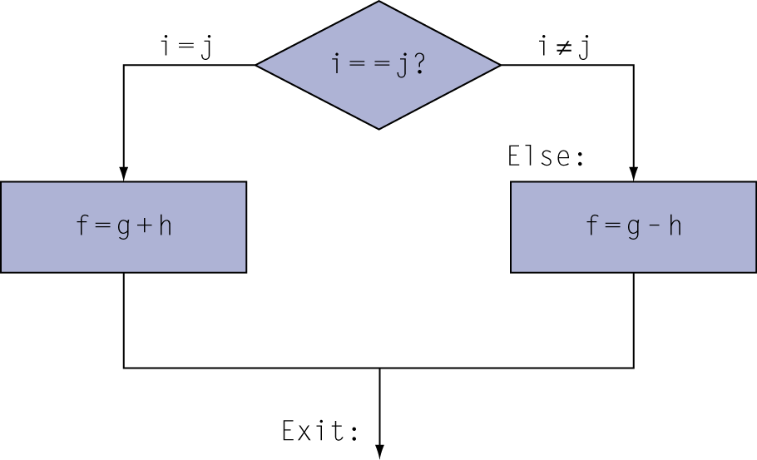
Compiling If Statements
C code:
if (i==j) f = g+h; else f = g-h;
f, g, … in $s0, $s1, …
Compiled MIPS code:
bne $s3, $s4, Else add $s0, $s1, $s2 j Exit Else: sub $s0, $s1, $s2 Exit: …
Assembler calculates addresses

Slide 37
Compiling Loop Statements
C code:
while (save[i] == k) i += 1;
i in $s3, k in $s5, address of save in $s6
Compiled MIPS code:
Loop: sll $t1, $s3, 2 # $t1 = i*4 add $t1, $t1, $s6 lw $t0, 0($t1) bne $t0, $s5, Exit addi $s3, $s3, 1 j Loop Exit: …
Notes:
循环指令

Slide 38
Basic Blocks
A basic block is a sequence of instructions with
No embedded branches (except at end)
No branch targets (except at beginning)
A compiler identifies basic blocks for optimization
An advanced processor can accelerate execution of basic blocks
Notes:
基本的结构， 既没有嵌入的分支语句，除了在结束除外，也没有分支程序的入口（除了起始位置之外）
基本程序块是编译器识别并优化的程序块，一些先进的处理器可以加快基本快的执行

Slide 39
More Conditional Operations
Set result to 1 if a condition is true
Otherwise, set to 0
slt rd, rs, rt
if (rs < rt) rd = 1; else rd = 0;
slti rt, rs, constant
if (rs < constant) rt = 1; else rt = 0;
Use in combination with beq, bne
slt $t0, $s1, $s2 # if ($s1 < $s2) bne $t0, $zero, L # branch to L
Notes:
条件赋值操作指令

Slide 40
Branch Instruction Design
Why not blt, bge, etc?
Hardware for <, ≥, … slower than =, ≠
Combining with branch involves more work per instruction, requiring a slower clock
All instructions penalized!
beq and bne are the common case
This is a good design compromise
Notes:
分支指令的设计
对于硬件来说 < 运行时间比= ，不等于慢
如果将比较和分支在一条指令中将会包含更多的操作，从而导致更慢的时钟，从而导致所有的指令都变慢
另一方面beq and bne 更常用

Slide 41
Signed vs. Unsigned
Signed comparison: slt, slti
Unsigned comparison: sltu, sltui
Example
$s0 = 1111 1111 1111 1111 1111 1111 1111 1111
$s1 = 0000 0000 0000 0000 0000 0000 0000 0001
slt $t0, $s0, $s1 # signed
–1 < +1 ⇒ $t0 = 1
sltu $t0, $s0, $s1 # unsigned
+4,294,967,295 > +1 ⇒ $t0 = 0

Slide 42
Procedure Calling
Procedures enable structured programs
Easier to understand and reuse code
Steps required
Place parameters in registers
Transfer control to procedure
Acquire storage for procedure
Perform procedure’s operations
Place result in register for caller
Return to place of call
§2.8 Supporting Procedures in Computer Hardware
Notes:
过程调用
过程调用的步骤
放置参数– 转移控制—申请局部变量内存（同时fp指向sp）---过程任务—放置结果到寄存器—返回调用的位置

Slide 43
Register Usage
$a0 – $a3: arguments (reg’s 4 – 7)
$v0, $v1: result (i.e. return) values (reg’s 2 and 3)
$t0 – $t9: temporaries
Can be overwritten by callee
$s0 – $s7: saved
Must be saved/restored by callee
$gp: global pointer for static data (reg 28)
$sp: stack pointer (reg 29)
$fp: frame pointer (reg 30)
$ra: return address (reg 31)

Slide 44
Procedure Call Instructions
Procedure call: jump and link
jal ProcedureLabel
Address of following instruction put in $ra
Jumps to target address
Procedure return: jump register
jr $ra
Copies $ra to program counter
Can also be used for computed jumps
e.g., for case/switch statements
Notes:
过程调用指令， 将当前指令的下一条指令地址放到$ra中

Slide 45
Leaf Procedure Example
C code:
int leaf_example (int g, h, i, j) { int f; f = (g + h) - (i + j); return f; }
Arguments g, …, j in $a0, …, $a3
f in $s0 (hence, need to save $s0 on stack)
Result in $v0
Notes:
叶子过程，不包含其他过程调用的过程（函数）

Slide 46
Leaf Procedure Example
MIPS code:
leaf_example: addi $sp, $sp, -4 sw $s0, 0($sp) add $t0, $a0, $a1 add $t1, $a2, $a3 sub $s0, $t0, $t1 add $v0, $s0, $zero lw $s0, 0($sp) addi $sp, $sp, 4 jr $ra
Save $s0 on stack
Procedure body
Result
Restore $s0
Return
Think about the differences between 80x86 and MIPS Procedure Instructions!
Notes:
最后 请大家思考一下 jal 与8086 call操作的区别？ 那个执行效率更高？

Slide 47
Non-Leaf Procedures
Procedures that call other procedures
For nested call, caller needs to save on the stack:
Any saved registers being used $s0-$s7
Its return address
Any arguments and temporaries needed after the call
e.g., suppose main program calls procedure A with an argument 3 in $a0 and then using jal A
Then if procedure A calls procedure B via jal B with an argument of 7 placed in $a0, there is a conflict over the use of register $a0
Restore from the stack after the call
Notes:
非叶子过程（函数），调用了其他的函数或者过程

Slide 48
Non-Leaf Procedure Example
C code:
int fact (int n) { if (n < 1) return 1; else return n * fact(n - 1); }
Argument n in $a0
Result in $v0

Slide 49
Non-Leaf Procedure Example
MIPS code:
fact: addi $sp, $sp, -8 # adjust stack for 2 items sw $ra, 4($sp) # save return address sw $a0, 0($sp) # save argument slti $t0, $a0, 1 # test for n < 1 beq $t0, $zero, L1 addi $v0, $zero, 1 # if so, result is 1 addi $sp, $sp, 8 # pop 2 items from stack jr $ra # and return L1: addi $a0, $a0, -1 # else decrement n jal fact # recursive call lw $a0, 0($sp) # restore original n lw $ra, 4($sp) # and return address addi $sp, $sp, 8 # pop 2 items from stack mul $v0, $a0, $v0 # multiply to get result jr $ra # and return
Notes:
$ra 特殊的寄存器，用来保存当前程序执行的地址计数器PC的值（当前指令的下一条指令）

Slide 50
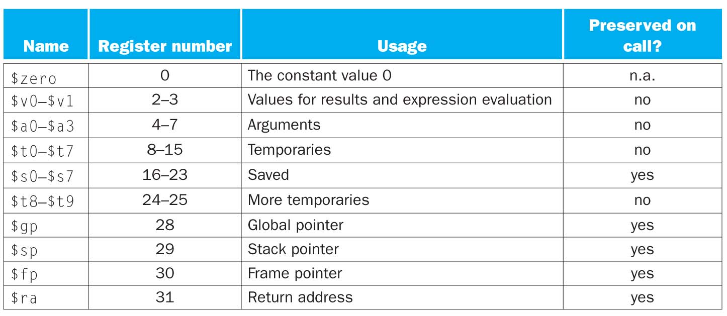
MIPS Register Conventions
Register 1, called $at, is reserved for the assembler and registers 26−27, called $k0−$k1, are reserved for the operating system.
Notes:
convention [con·ven·tion || kən'venʃn]
n. 大会; 习俗; 协定

Slide 51
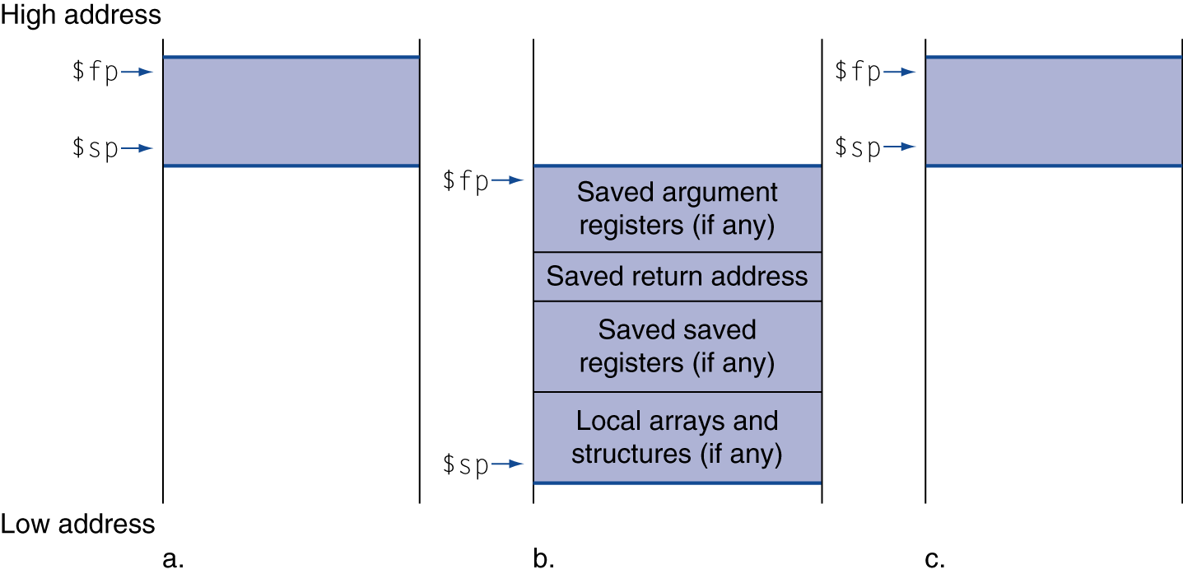
Local Data on the Stack
Local data allocated by callee
e.g., C automatic variables
Procedure frame (activation record)
Used by some compilers to manage stack storage
Notes:
局部变量是存放在
堆栈中的

Slide 52
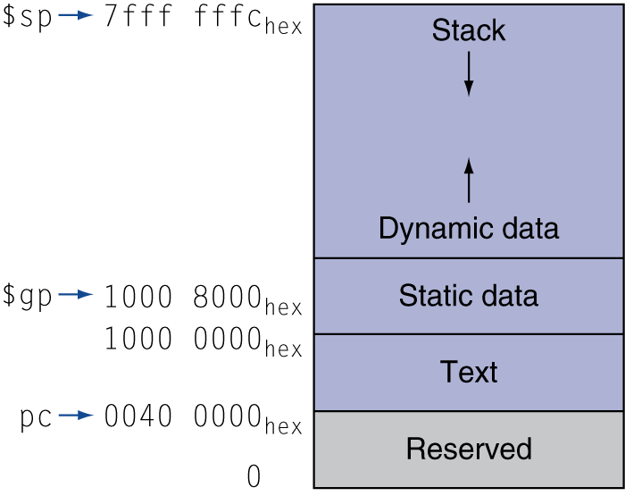
Memory Layout
Text: program code
Static data: global variables
e.g., static variables in C, constant arrays and strings
$gp initialized to address allowing ±offsets into this segment
Dynamic data: heap
E.g., malloc() in C, new in Java, linked lists
Must use free() in C
Memory leak issues!
Stack: automatic storage
Notes:
内存中布局
主要是了解什么是静态数据 和 动态数据

Slide 53
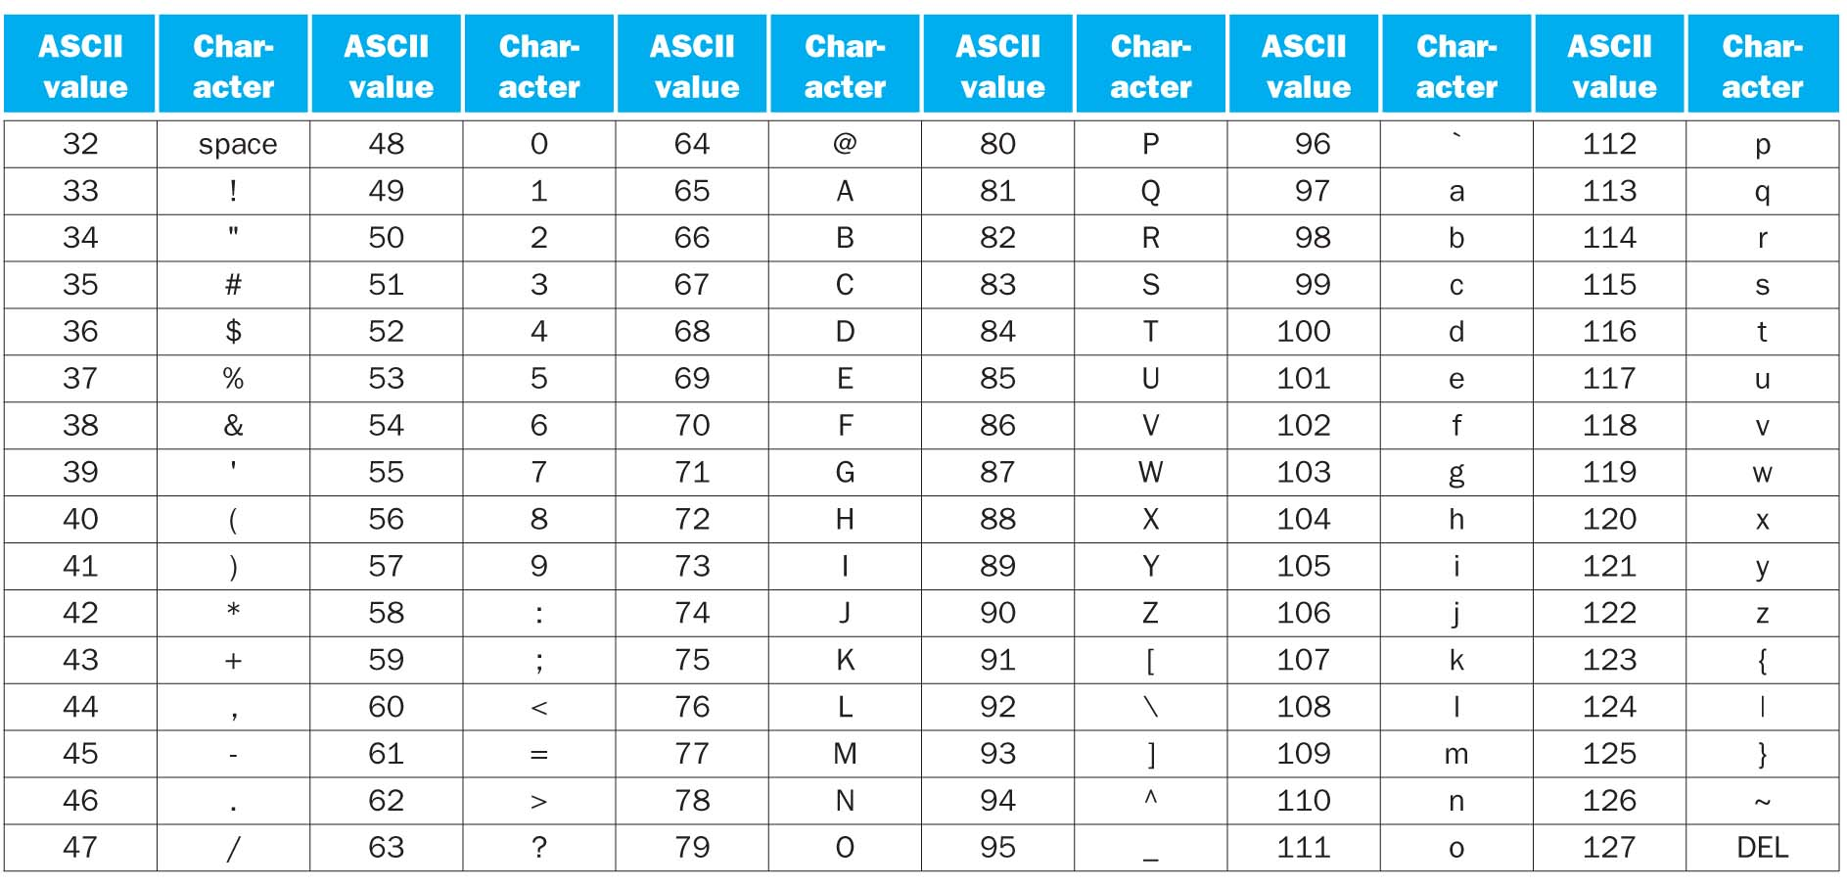
Character Data
Byte-encoded character sets
ASCII: 128 characters
95 graphic, 33 non-printable control (almost obsolete now)
Latin-1: 256 characters
ASCII, +96 more graphic characters
§2.9 Communicating with People
Notes:
以上 介绍了数字逻辑运算指令集以及程序中数据存储问题
那么如何实现 人机交互呢？

Slide 54
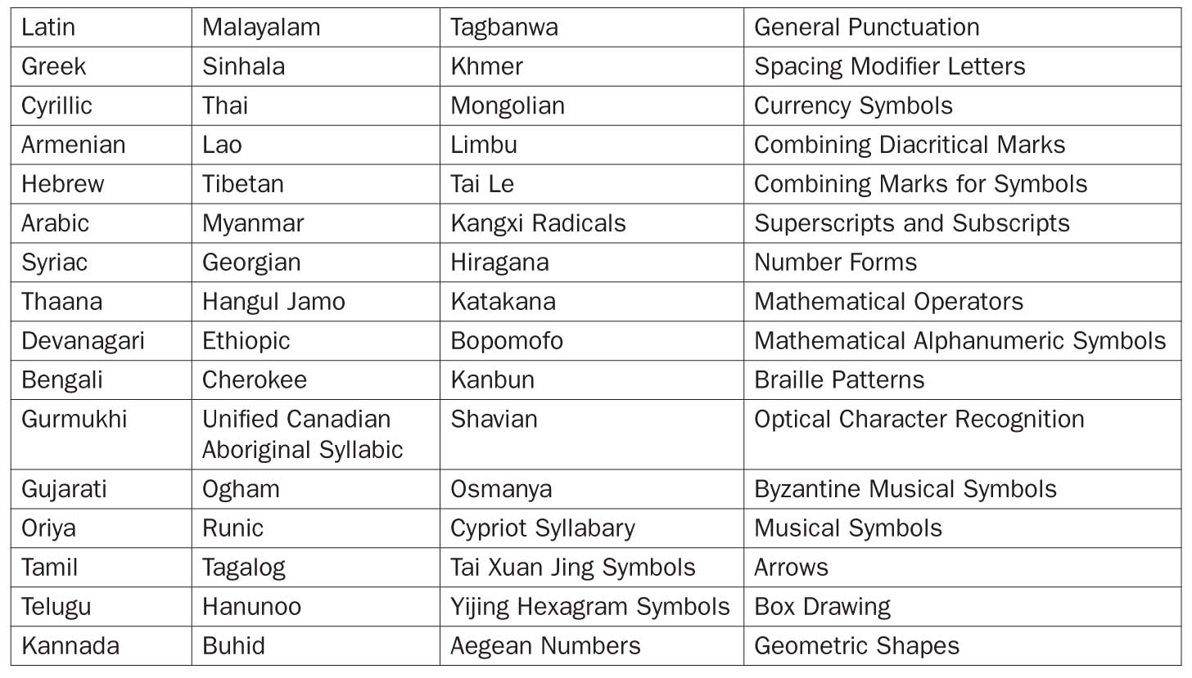
Character Data
Unicode: 32-bit character set
Used in Java, C++ wide characters, …
UTF-8, UTF-16: variable-length encodings
Most of the world’s alphabets, plus symbols
Notes:
字符数据 存储方式，我们 可以发现多数的字符表示方法是8位或者16位的数据？这与MIPS 32中字的长度不匹配，如何来解决该问题呢？

Slide 55
Byte/Halfword Operations
To manipulate text (e.g. ASCII characters) byte operations are essential
MIPS byte/halfword load/store
String processing is a common case
lb rt, offset(rs) lh rt, offset(rs)
Sign extend to 32 bits in rt
lbu rt, offset(rs) lhu rt, offset(rs)
Zero extend to 32 bits in rt
sb rt, offset(rs) sh rt, offset(rs)
Store just rightmost byte/halfword
Notes:
lb rt, offset(rs) 加载字节 ； lh rt, offset(rs) 加载半字
sb rt, offset(rs) 存储字节 sh rt, offset(rs) 存储半字

Slide 56
String Copy Example
C code (naïve):
Null-terminated string
void strcpy (char x[], char y[]) { int i; i = 0; while ((x[i]=y[i])!='\0') i += 1; }
Addresses of x, y in $a0, $a1
i in $s0

Slide 57
String Copy Example
MIPS code:
strcpy: addi $sp, $sp, -4 # adjust stack for 1 item sw $s0, 0($sp) # save $s0 add $s0, $zero, $zero # i = 0 L1: add $t1, $s0, $a1 # addr of y[i] in $t1 lbu $t2, 0($t1) # $t2 = y[i] add $t3, $s0, $a0 # addr of x[i] in $t3 sb $t2, 0($t3) # x[i] = y[i] beq $t2, $zero, L2 # exit loop if y[i] == 0 addi $s0, $s0, 1 # i = i + 1 j L1 # next iteration of loop L2: lw $s0, 0($sp) # restore saved $s0 addi $sp, $sp, 4 # pop 1 item from stack jr $ra # and return

Slide 58
32-bit Constants
Most constants are small
16-bit immediate is sufficient
For the occasional 32-bit constant
lui rt, constant
Copies 16-bit const to left 16 bits of rt; Clears right 16 bits of rt
Example: how can we load 32 bit constant into $s0?
0000 0000 0111 1101 0000 1001 0000 0000
Typically assembler is responsible for breaking a large constant and reassembling into a register (using the reserved register $at)
§2.10 MIPS Addressing for 32-Bit Immediates and Addresses
lui $s0, 61
0000 0000 0111 1101 0000 0000 0000 0000
ori $s0, $s0, 2304
0000 0000 0111 1101 0000 1001 0000 0000
Notes:
如何处理32位的常数
由于16位的常数对于大多数的应用已经足够了

Slide 59
Branch Addressing
Branch instructions specify
Opcode, two registers, target address
If addresses had to fit in 16-bits, then no program could be bigger than 2¹⁶
op
rs
rt
constant or address
6 bits
5 bits
5 bits
16 bits
PC-relative addressing
Target address = PC + offset × 4
PC already incremented by 4 by this time
Almost all loops and if statements < 2¹⁶ words
Notes:
分支程序 的寻址和指令的表示方式
2¹⁶ = 64K

Slide 60
Jump Addressing
Jump (j and jal) targets could be anywhere in text segment
Encode full address in instruction
op
address
6 bits
26 bits
(Pseudo)Direct jump addressing
Target address = PC_{31…28} : (address × 4)
Notes:
无条件跳转 ，26位+2 =28位
由于每条指令的长度为4个字节，因此26位可以看成是跳转地址与当前地址之间间隔的指令数量

Slide 61
Branching Far Away
If branch target is too far to encode with 16-bit offset, assembler rewrites the code
Example: how can we increase branching distance for the following instruction?
beq $s0,$s1, L1
↓
bne $s0,$s1, L2 j L1 L2: …
Notes:
条件跳转语句的跳转范围有限，如果跳转的范围超过了+- 32K的范围
简单地在原有的短跳转指令beq $s0,$s1, L1，转化为bne 指令，并后面增加一条指令 j L1,并将原有指令的跳转地址修改为J L1后面的指令即可。

Slide 62
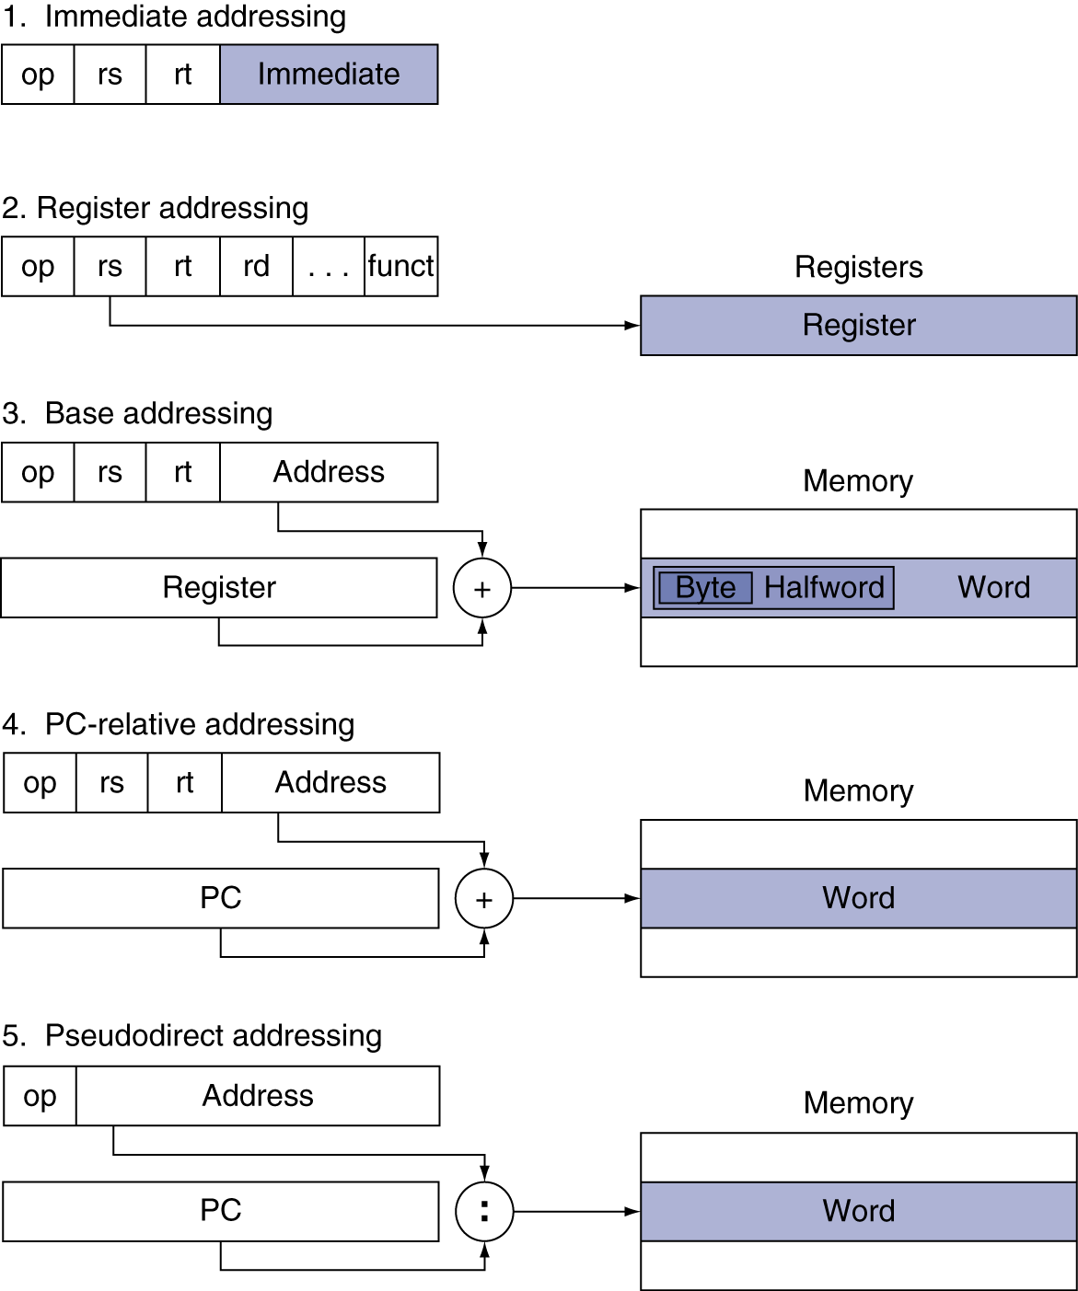
Addressing Mode Summary
Notes:
pseudo ['suːdəʊ /'sju-]
adj. 假的; 冒充的 伪直接寻址

Slide 63
Synchronization
Two processors sharing an area of memory
P1 writes, then P2 reads
Data race if P1 and P2 don’t synchronize
Result depends of order of accesses
Hardware and ISA support required
Atomic read/write memory operation
No other access to the location allowed between the read and write
Could be a single instruction
E.g., atomic swap of register ↔ memory
Or an atomic pair of instructions
§2.11 Parallelism and Instructions: Synchronization
Notes:
同步控制，在多道程序环境下（进程切换是随机的），多处理机系统或者 多核系统下，经常会出现资源竞争的问题。
例如 两个处理机需要访问同一个内存区域，由于其结果取决于访问的顺序，导致程序运行的结果不可预测。
因此需要ISA在硬件上支持原子的读写操作之间不允许其他的操作。
具体实现上，可以采用单独的指令来实现寄存器与内存单元数据之间的原子交换，
或者利用原子操作的指令对来实现。

Slide 64
Motivation for Atomic Swap
Build lock for multi-processor system
To govern access to some critical resource
0 indicates lock is free; 1 indicates lock is unavailable; “lock” stored in memory
Processor tries to set the lock by doing an exchange of 1 which is in a register
Value returned from exchange is
1 if another processor already acquired the lock;
0 otherwise; in this case value changed to 1 to prevent another processor from retrieving 0
Locks allow breaking race conditions
Notes:
为多处理器系统构建锁的机制。
目的 1 临界资源
其具体的实现方式是，假定 0 是锁是打开的， 1 表示对临界区资源加锁
那么处理器需要加锁就是通过将寄存器中的 1 与临界区（内存变量）之间进行原子交换，在交换过程中其值不能被修改。
利用锁的机制可以避免竞争条件。

Slide 65
Synchronization in MIPS
Load linked: ll rt, offset(rs)
Store conditional: sc rt, offset(rs)；rt->(rs)
Succeeds if location not changed since the ll
Returns 1 in rt
Fails if location is changed
Returns 0 in rt
Example: atomic swap (to test/set lock variable)
try: add $t0,$zero,$s4 ;copy exchange value
ll $t1,0($s1) ;load linked 相当于加锁机制
sc $t0,0($s1) ;store conditional
beq $t0,$zero,try ;branch store fails
add $s4,$zero,$t1 ;put load value in $s4
ll, sc can be used to build other synchronization primitives: atomic compare and swap, fetch and increment, etc.
Notes:
LL指令 可以看成是对指定的内存单元加锁的机制。
ll $t1,0($s1)，相当于将内存单元读出到 $t1寄存器中
指令LL 可以作为其他原子操作实现的基础。

Slide 66
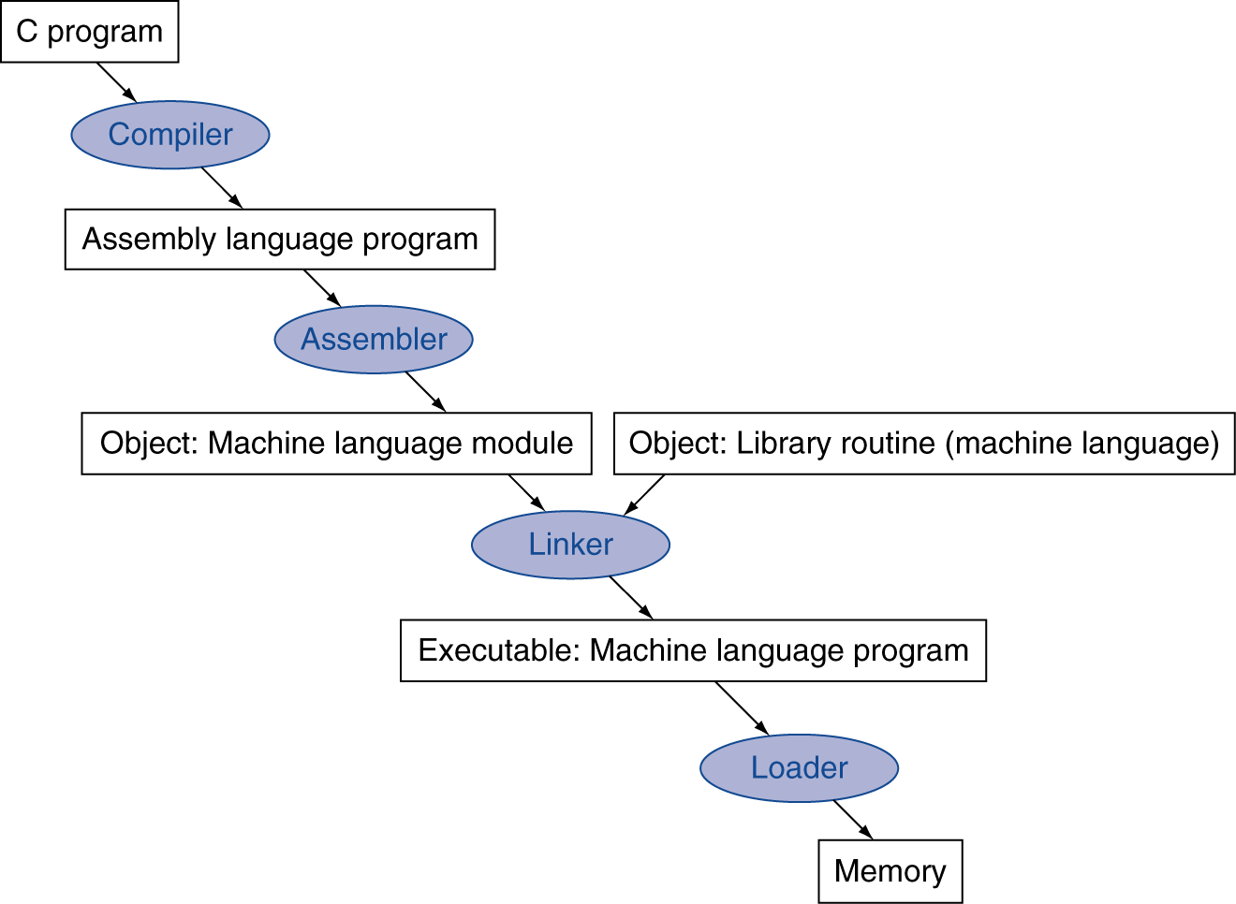
Translation and Startup
Many compilers produce object modules directly
§2.12 Translating and Starting a Program
Static linking
Notes:
编译和启动程序

Slide 67
Assembler Pseudoinstructions
Most assembler instructions represent machine instructions one-to-one
Pseudoinstructions: figments of the assembler’s imagination
move $t0, $t1 → add $t0, $zero, $t1
blt $t0, $t1, L → slt $at, $t0, $t1 bne $at, $zero, L
$at (register 1): assembler temporary
Notes:
figment [fig·ment || 'fɪgmənt]
n. 臆造的事物; 虚构的事
汇编伪指令， 是虚拟出来的指令，利于Move 指令和blt 指令，本身MIPS中没有包含这些指令，为了编程方便，虚拟出来的指令。

Slide 68
Producing an Object Module
Assembler (or compiler) translates program into machine instructions
Provides information for building a complete program from the pieces
E.g. object file (*.o) for UNIX has 6 distinct parts:
Header: described contents of object module
Text segment: translated instructions
Static data segment: data allocated for the life of the program
Relocation info: for contents that depend on absolute location of loaded program
Symbol table: global definitions and external refs
Debug info: for associating machine code with high level source code by debuggers
Notes:
生成目标程序（将汇编指令编译成目标计算机的机器代码），此外提供一些信息能够将代码片段编译成完整的程序
例如Unix的目标程序包含6个不同的部分
文件头、代码区、静态数据区、重定位信息、符号表、调试信息

Slide 69
Linking Object Modules
Produces an executable image
1. Merges segments/object files/procedures
Rather than compiling/assembling whole program when a single line of a procedure is changed, procedures are compiled/assembled independently
2. Resolve labels (determine their addresses)
3. Patch location-dependent and external refs
Notes:
链接目标代码
整合段或者目标程序
解析标号地址
将与位置相关和外部参考文件补上。

Slide 70
Loading a Program
Load from image file on disk into memory
1. Read header to determine segment sizes
2. Create virtual address space
3. Copy text and initialized data into memory
Or set page table entries so they can be faulted in
4. Set up arguments on stack
5. Initialize registers (including $sp, $fp, $gp)
6. Jump to startup routine
Copies arguments to $a0, … and calls main
When main returns, do exit syscall
Notes:
加载程序流程：
首先实现影像文件加载到内存中
1） 读出文件头（包含重定位表信息）
2） 创建虚拟地址空间（为程序在物理空间中申请内存资源）
3）将代码和数据加载到内存中，需要进行（重定位）操作
4）设置参数和堆栈
5）初始化寄存器
6）跳转到起始线程

Slide 71
Static and Dynamic Linking
So far discussed traditional approach to linking libraries before program executes
Static linking
If new version of a library released to fix bugs or support new hardware, statically linked program keeps using old version
All routines in a library are loaded, even if they are not used
Dynamic linking: Do not link/load library routines until program is run
Requires procedure code to be relocatable
Automatically picks up new library versions
Dynamically linked libraries (DLLs)
Notes:
静态连接和动态连接知识

Slide 72
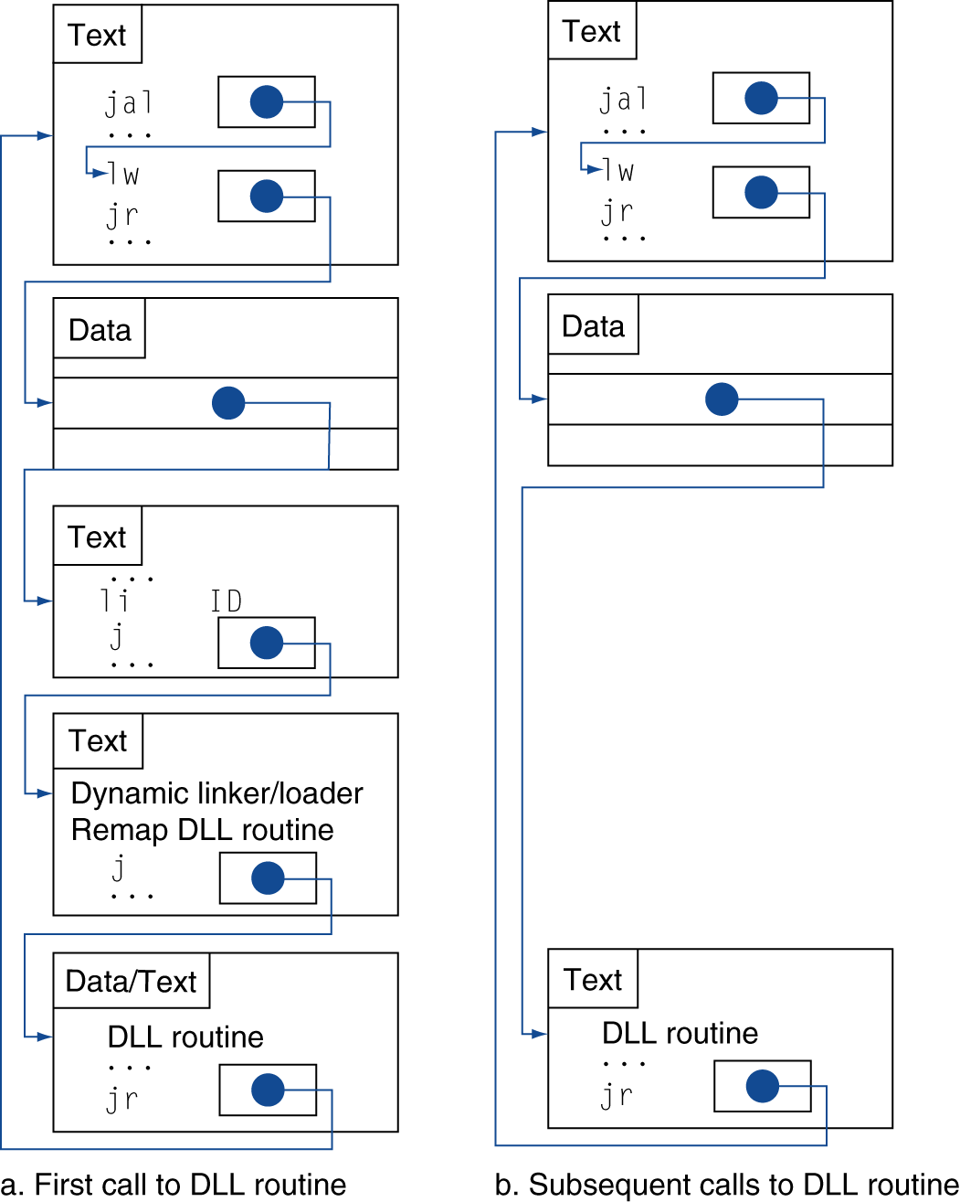
Lazy Linkage
Routine linked only after it is called
Avoids image bloat caused by static linking of all referenced libraries
Indirection table
Stub: Loads routine ID, Jump to linker/loader
Linker/loader code
Dynamically mapped code
Notes:
bloat [bləʊt]
v. 使膨胀; 使自大; 使肿起; 腌熏; 膨胀; 得意; 肿起

Slide 73
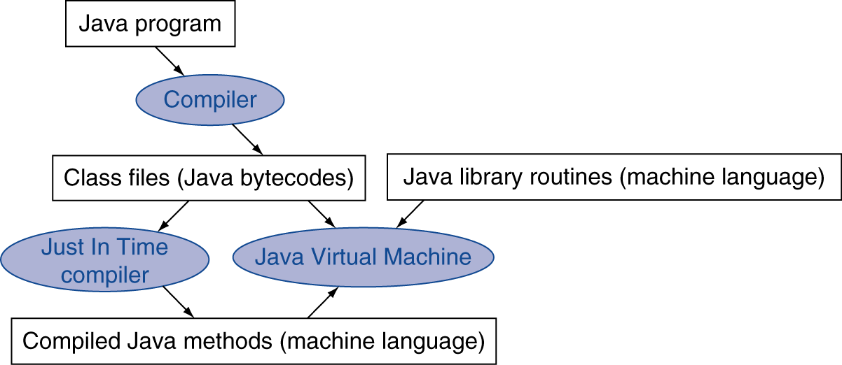
Starting Java Applications
Simple portable instruction set for the JVM
Compiles bytecodes of “hot” methods into native code for host machine
Interprets bytecodes
Notes:
Java应用程序的执行

Slide 74
C Sort Example
Illustrates use of assembly instructions for a C bubble sort function
Swap procedure (leaf)
void swap(int v[], int k) { int temp; temp = v[k]; v[k] = v[k+1]; v[k+1] = temp; }
v in $a0, k in $a1, temp in $t0
§2.13 A C Sort Example to Put It All Together
Notes:
我们介绍完指令集，编译和连接过程以及程序装载的过程，
下面我们以一个交换排序的例子来进行说明
一个C语言的排序例子

Slide 75
The Procedure Swap
swap: sll $t1, $a1, 2 # $t1 = k * 4
add $t1, $a0, $t1 # $t1 = v+(k*4)
# (address of v[k])
lw $t0, 0($t1) # $t0 (temp) = v[k]
lw $t2, 4($t1) # $t2 = v[k+1]
sw $t2, 0($t1) # v[k] = $t2 (v[k+1])
sw $t0, 4($t1) # v[k+1] = $t0 (temp)
jr $ra # return to calling routine
Forgetting that sequential word addresses differ by 4 instead of 1 is a common mistake in assembly language programming

Slide 76
The Sort Procedure in C
Non-leaf bubble/exchange sort (calls swap)
void sort (int v[], int n)
{
int i, j;
for (i = 0; i < n; i += 1) {
for (j = i – 1;
j >= 0 && v[j] > v[j + 1];
j -= 1) {
swap(v,j);
}
}
}
v in $a0, n in $a1, i in $s0, j in $s1

Slide 77
The Procedure Body
move $s2, $a0 # save $a0 into $s2
move $s3, $a1 # save $a1 into $s3
move $s0, $zero # i = 0
for1tst: slt $t0, $s0, $s3 # $t0 = 0 if $s0 ≥ $s3 (i ≥ n)
beq $t0, $zero, exit1 # go to exit1 if $s0 ≥ $s3 (i ≥ n)
addi $s1, $s0, –1 # j = i – 1
for2tst: slti $t0, $s1, 0 # $t0 = 1 if $s1 < 0 (j < 0)
bne $t0, $zero, exit2 # go to exit2 if $s1 < 0 (j < 0)
sll $t1, $s1, 2 # $t1 = j * 4
add $t2, $s2, $t1 # $t2 = v + (j * 4)
lw $t3, 0($t2) # $t3 = v[j]
lw $t4, 4($t2) # $t4 = v[j + 1]
slt $t0, $t4, $t3 # $t0 = 0 if $t4 ≥ $t3
beq $t0, $zero, exit2 # go to exit2 if $t4 ≥ $t3
move $a0, $s2 # 1st param of swap is v (old $a0)
move $a1, $s1 # 2nd param of swap is j
jal swap # call swap procedure
addi $s1, $s1, –1 # j –= 1
j for2tst # jump to test of inner loop
exit2: addi $s0, $s0, 1 # i += 1
j for1tst # jump to test of outer loop
Move params
Outer loop
Inner loop
Pass params & call
Inner loop
Outer loop

Slide 78
The Full Procedure
sort: addi $sp,$sp, –20 # make room on stack for 5 registers
sw $ra, 16($sp) # save $ra on stack
sw $s3,12($sp) # save $s3 on stack
sw $s2, 8($sp) # save $s2 on stack
sw $s1, 4($sp) # save $s1 on stack
sw $s0, 0($sp) # save $s0 on stack
… # procedure body
…
exit1: lw $s0, 0($sp) # restore $s0 from stack
lw $s1, 4($sp) # restore $s1 from stack
lw $s2, 8($sp) # restore $s2 from stack
lw $s3,12($sp) # restore $s3 from stack
lw $ra,16($sp) # restore $ra from stack
addi $sp,$sp, 20 # restore stack pointer
jr $ra # return to calling routine

Slide 79
Effect of Compiler Optimization
Compiled with gcc for Pentium 4 under Linux
Notes:
01 中等优化， 02 完全， 03， 过程集成
-O0：这个等级（字母“O”后面跟个零）关闭所有优化选项，也是CFLAGS或CXXFLAGS中没有设置-O等级时的默认等级。不会优化代码，这通常不是我们想要的。 -O1：这是最基本的优化等级。编译器会在不花费太多编译时间的同时试图生成更快更小的代码。这些优化是非常基础的，但一般这些任务肯定能顺利完成。 -O2：-O1的进阶。这是推荐的优化等级，除非你有特殊的需求。-O2会比-O1启用多一些标记。设置了-O2后，编译器会试图提高代码性能而不会增大体积和大量占用的编译时间。 -O3：这是最高最危险的优化等级。用这个选项会延长编译代码的时间，并且在使用gcc4.x的系统里不应全局启用。自从3.x版本以来gcc的行为已经有了极大地改变。在3.x，-O3生成的代码也只是比-O2快一点点而已，而gcc4.x中还未必更快。用-O3来编译所有的软件包将产生更大体积更耗内存的二进制文件，大大增加编译失败的机会或不可预知的程序行为（包括错误）。这样做将得不偿失，记住过犹不及。在gcc 4.x.中使用-O3是不推荐的。
-O -O1优化.对于大函数,优化编译占用稍微多的时间和相当大的内存. 不使用`-O'选项时,编译器的目标是减少编译的开销,使编译结果能够调试.语句是独立的:如果在两条语句之间用断点中止程序,你可以对任何变量重新赋值,或者在函数体内把程序计数器指到其他语句,以及从源程序中 精确地获取你期待的结果.
不使用`-O'选项时,只有声明了register的变量才分配使用寄存器.编译结果比不用`-O'选项的PCC要略逊一筹.
使用了`-O'选项,编译器会试图减少目标码的大小和执行时间.
如果指定了`-O'选项, `-f thread-jumps'和`-fdefer-pop'选项将被 打开.在有delay slot的机器上, `-fdelayed-branch'选项将被打开.在即使没有帧指针(frame pointer)也支持调试的机器上, `-fomit-frame-pointer'选项将被打开.某些机器上 还可能会打开其他选项.
-O2多优化一些.除了涉及空间和速度交换的优化选项,执行几乎所有的优化工作.例如不进行循环展开(loop unrolling)和函数内嵌(inlining).和-O选项比较,这个选项既增加了编译时间,也提高了生成代码的运行效果.
-O3优化的更多.除了打开-O2所做的一切,它还打开了-f inline-functions选项.
-O0不优化. 如果指定了多个-O选项,不管带不带数字,最后一个选项才是生效的选项.

Slide 80
Effect of Language and Algorithm
Notes:
快速排序相对冒泡排序性能的提升（100 000个数据）2500

Slide 81
Lessons Learnt
Instruction count and CPI are not good performance indicators in isolation
Compiler optimizations are sensitive to the algorithm
Java/JIT compiled code is significantly faster than JVM interpreted
Comparable to optimized C in some cases
Nothing can fix a dumb algorithm!

Slide 82
Arrays vs. Pointers
Array indexing involves
Multiplying index by element size
Adding to array base address
Pointers correspond directly to memory addresses
Can avoid indexing complexity
§2.14 Arrays versus Pointers
Notes:
数组和指针

Slide 83
Example: Clearing an Array
clear1(int array[], int size) { int i; for (i = 0; i < size; i += 1) array[i] = 0; } | clear2(int *array, int size) { int *p; for (p = &array[0]; p < &array[size]; p = p + 1) *p = 0; }
move $t0,$zero # i = 0 loop1: sll $t1,$t0,2 # $t1 = i * 4 add $t2,$a0,$t1 # $t2 = # &array[i] sw $zero, 0($t2) # array[i] = 0 addi $t0,$t0,1 # i = i + 1 slt $t3,$t0,$a1 # $t3 = # (i < size) bne $t3,$zero,loop1 # if (…) # goto loop1 | move $t0,$a0 # p = & array[0] sll $t1,$a1,2 # $t1 = size * 4 add $t2,$a0,$t1 # $t2 = # &array[size] loop2: sw $zero,0($t0) # Memory[p] = 0 addi $t0,$t0,4 # p = p + 4 slt $t3,$t0,$t2 # $t3 = #(p<&array[size]) bne $t3,$zero,loop2 # if (…) # goto loop2
Notes:
比较两个程序性能的差异
使用指针速度更快，因为循环体内的指令更少

Slide 84
Comparison of Array vs. Ptr
Multiply “strength reduced” to shift
Array version requires shift to be inside loop
Part of index calculation for incremented i
c.f. incrementing pointer
Compiler can achieve same effect as manual use of pointers
Induction variable elimination
Better to make program clearer and safer
Avoid using pointers!!
Notes:
乘法指令被 降低为移位操作
数组版本 需要被移进循环体中
尽管在汇编指令这一层上 编译器优化技术可以获得类似的效果。例如变量约简，

Slide 85
ARM & MIPS Similarities
ARM: the most popular embedded core
Similar basic set of instructions to MIPS
§2.16 Real Stuff: ARM Instructions
 | ARM | MIPS
Date announced | 1985 | 1985
Instruction size | 32 bits | 32 bits
Address space | 32-bit flat | 32-bit flat
Data alignment | Aligned | Aligned
Data addressing modes | 9 | 3
Registers | 15 × 32-bit | 31 × 32-bit
Input/output | Memory mapped | Memory mapped

Slide 86
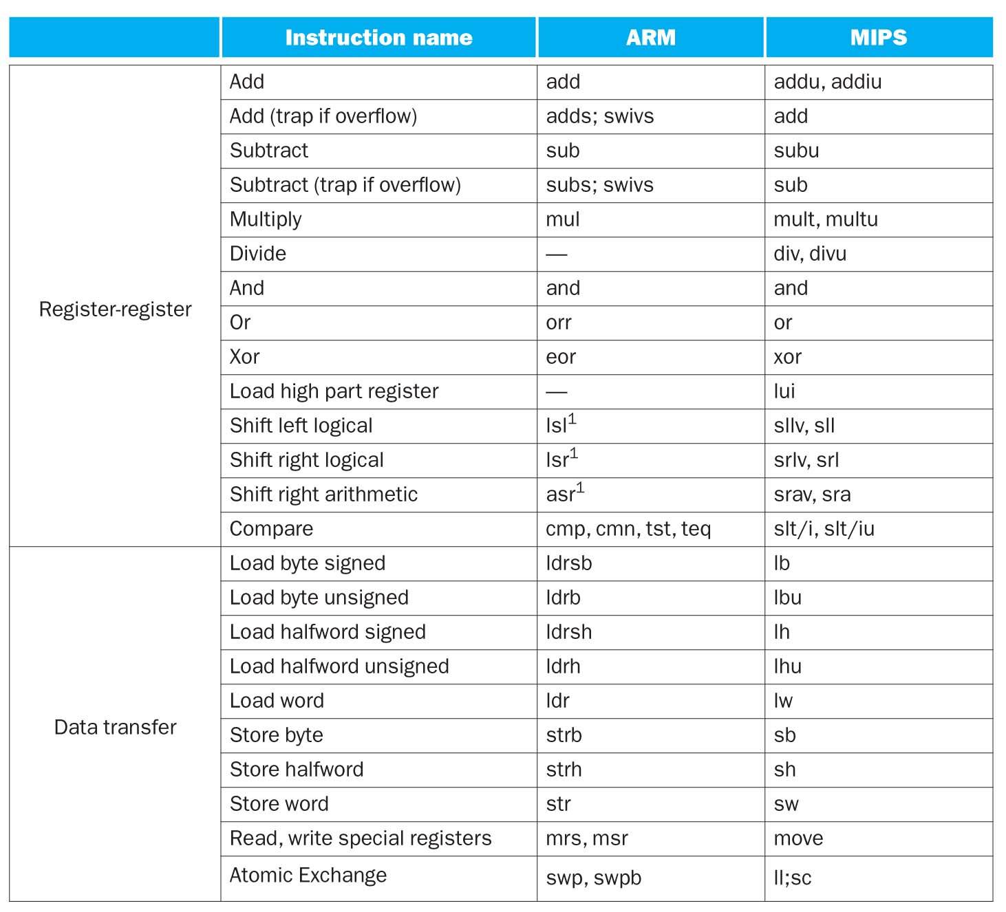
ARM & MIPS Similarities

Slide 87
Compare and Branch in ARM
Uses condition codes for result of an arithmetic/logical instruction
Negative, zero, carry, overflow
Compare (CMP) instructions to set condition codes without keeping the result
Subtracts one operand from the other
Each instruction can be conditional
Top 4 bits of instruction word: condition value
Can avoid branches over single instructions

Slide 88
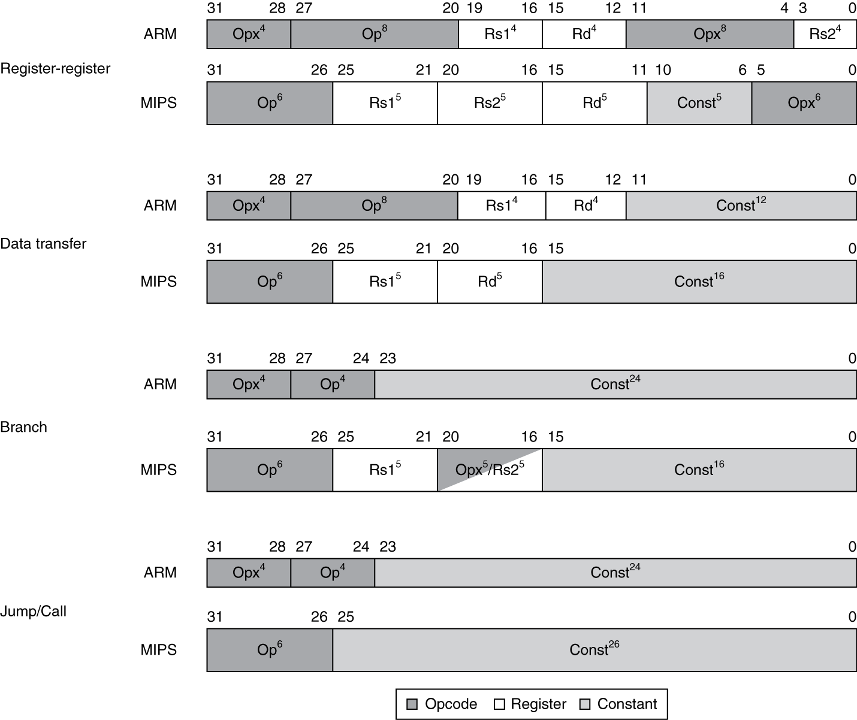
Instruction Encoding

Slide 89
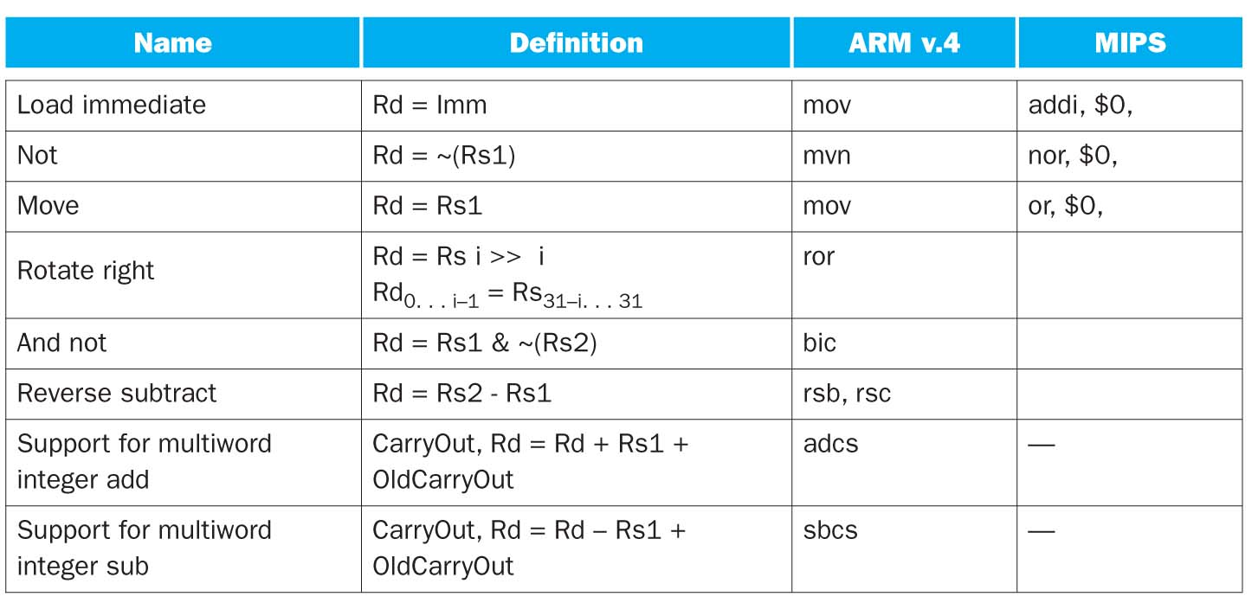
Unique ARM Instructions

Slide 90
The Intel x86 ISA
Evolution with backward compatibility
8080 (1974): 8-bit microprocessor
Accumulator, plus 3 index-register pairs
8086 (1978): 16-bit extension to 8080
Complex instruction set (CISC)
8087 (1980): floating-point coprocessor
Adds FP instructions and register stack
80286 (1982): 24-bit addresses, MMU
Segmented memory mapping and protection
80386 (1985): 32-bit extension (now IA-32)
Additional addressing modes and operations
Paged memory mapping as well as segments
§2.17 Real Stuff: x86 Instructions

Slide 91
The Intel x86 ISA
Further evolution…
i486 (1989): pipelined, on-chip caches and FPU
Compatible competitors: AMD, Cyrix, …
Pentium (1993): superscalar, 64-bit datapath
Later versions added MMX (Multi-Media eXtension) instructions
The infamous $500M FDIV bug
Pentium Pro (1995), Pentium II (1997)
New microarchitecture (see Colwell, The Pentium Chronicles)
Pentium III (1999)
Added SSE (Streaming SIMD Extensions) and associated registers
Pentium 4 (2001)
New microarchitecture
Added 144 SSE2 instructions

Slide 92
The Intel x86 ISA
And further…
AMD64 (2003): extended architecture to 64 bits
EM64T – Extended Memory 64 Technology (2004)
AMD64 adopted by Intel (with refinements)
Added SSE3 instructions
Intel Core (2006)
Added SSE4 instructions, virtual machine support
AMD64 (announced 2007): SSE5 instructions
Intel declined to follow, instead…
Advanced Vector Extension (announced 2008)
Longer SSE registers, more instructions
Existing x86 software base at each step too important to jeopardize with significant architectural changes
x86 extended by one instruction per month since inception!
is an architecture that is difficult to explain and hard to love
despite lacking “technical elegance”, x86 family pervasive today
Notes:
jeopardize (Amer.) [jeop·ard·ize || 'dʒepə(r)daɪz]
v. 危害, 使陷危地, 使受危困
one instruction per month 每个月增加一条指令，从出现后
尽管技术不够优雅，但是x86家族的机器比较普遍

Slide 93
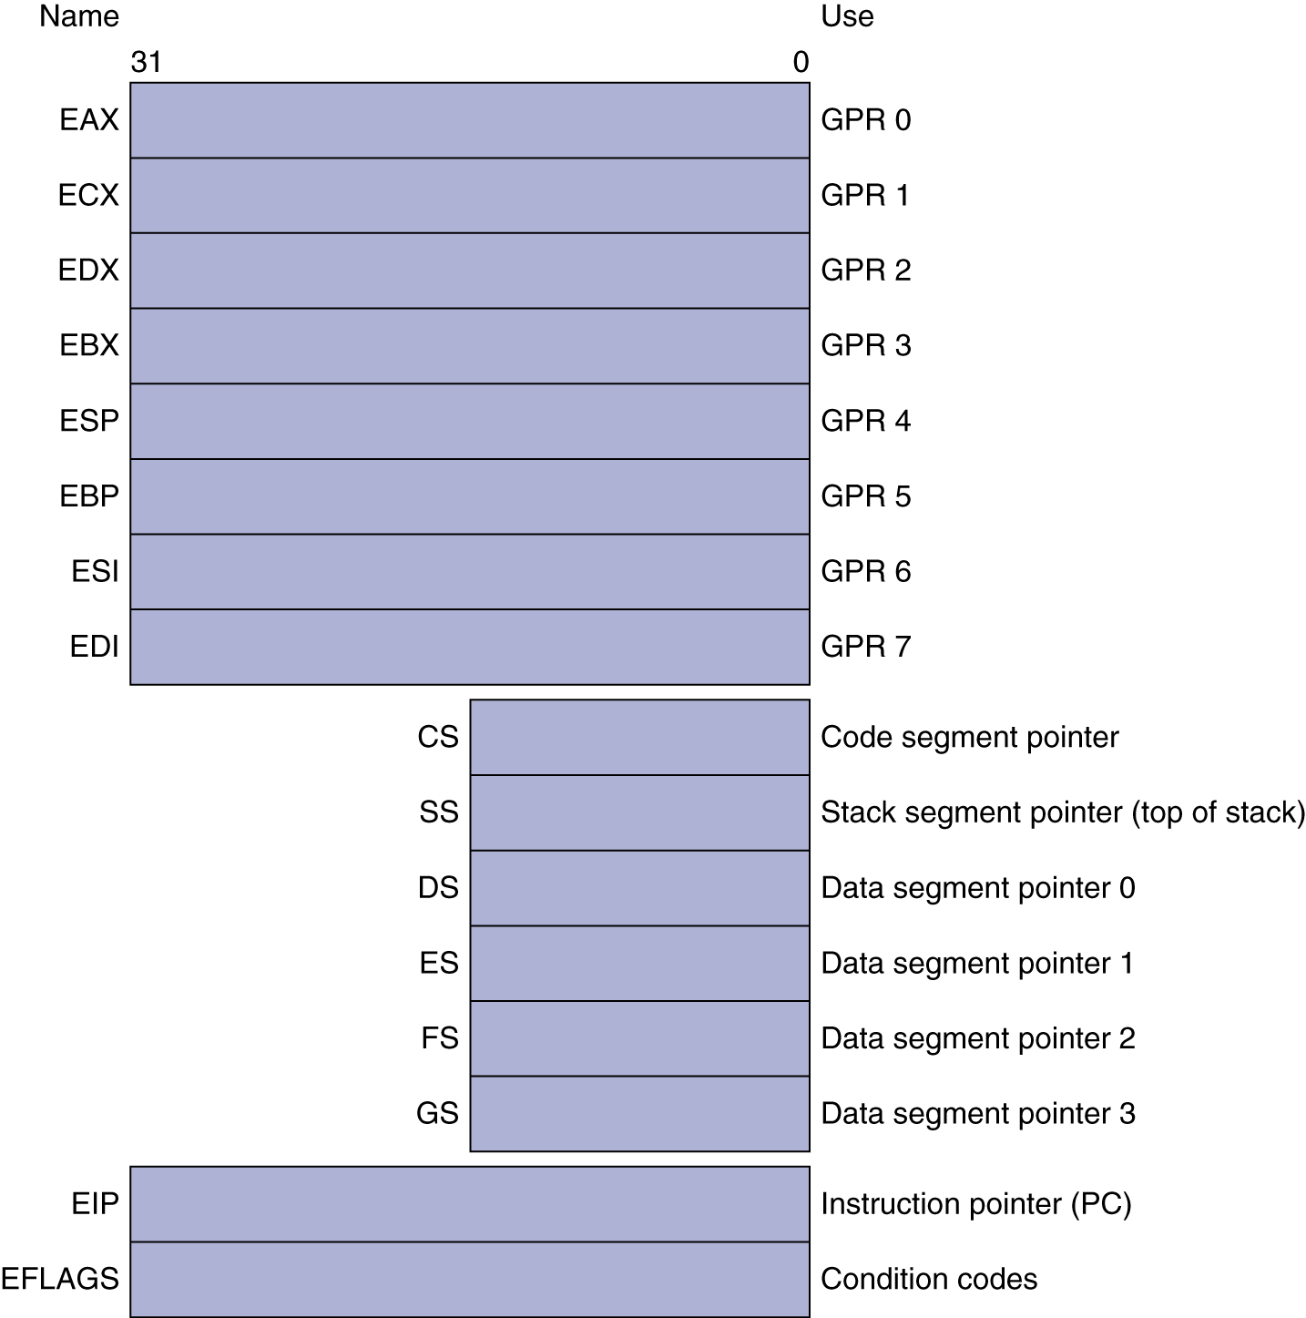
Basic x86 Registers (80386)

Slide 94
Basic x86 Addressing Modes
Two operands per instruction
Source/dest operand | Second source operand
Register | Register
Register | Immediate
Register | Memory
Memory | Register
Memory | Immediate
Memory addressing modes
Address in register
Address = R_{base} + displacement
Address = R_{base} + 2^{scale} × R_{index} (scale = 0, 1, 2, or 3)
Address = R_{base} + 2^{scale} × R_{index} + displacement

Slide 95
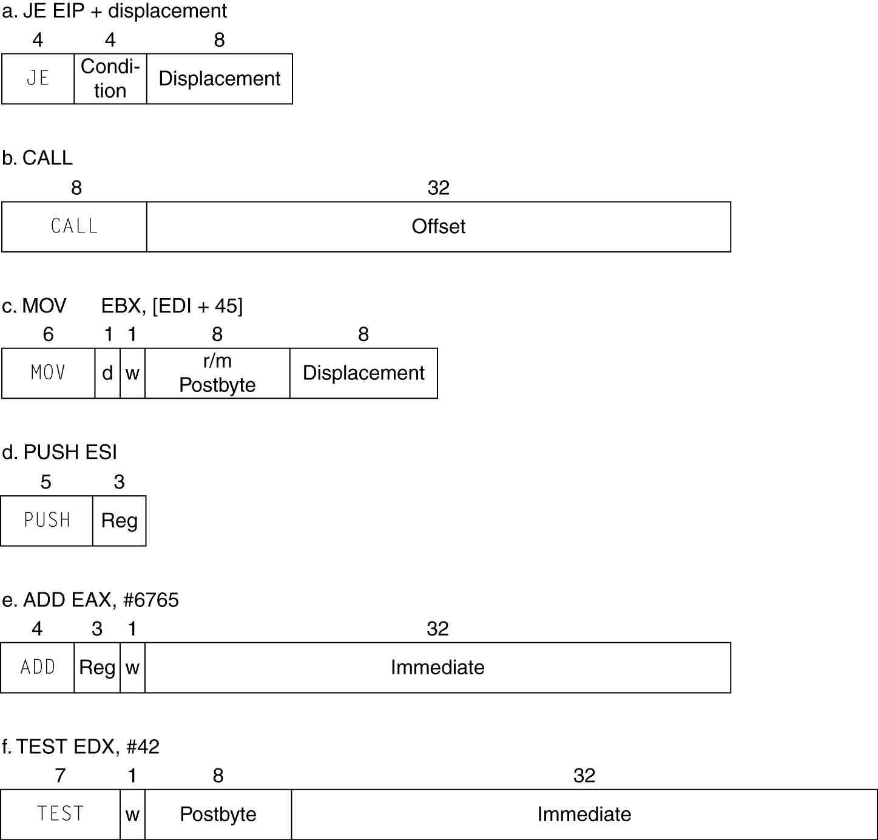
x86 Instruction Encoding
Variable length encoding
1 to 17 bytes
Rightly called CISC
Postfix bytes specify addressing mode
Prefix bytes modify operation
Operand length, repetition, locking, …

Slide 96
Implementing IA-32
Complex instruction set makes implementation difficult
Hardware translates instructions to simpler micro-operations
Simple instructions: 1–1
Complex instructions: 1–many
Microengine similar to RISC
Comparable performance to RISC
Compilers avoid complex instructions

Slide 97
Fallacies
Powerful instruction ⇒ higher performance
Fewer instructions required
But complex instructions are hard to implement
May slow down all instructions, including simple ones
Compilers are good at making fast code from simple instructions
Use assembly code for high performance
But modern compilers are better at dealing with modern processors
More lines of code (as is the case for assembly code vs. C or Java) ⇒ more errors and less productivity
§2.18 Fallacies and Pitfalls
Notes:
fallacy [fal·la·cy || 'fæləsɪ]
n. 谬误; 谬见; 谬论

Slide 98
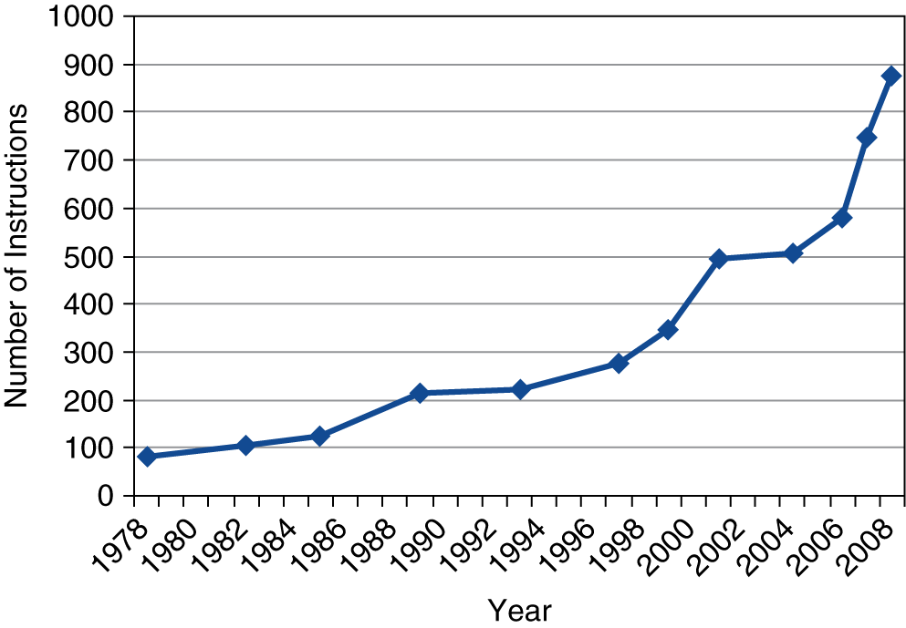
Fallacies
Backward compatibility ⇒ instruction set doesn’t change
But they do accrue more instructions
x86 instruction set

Slide 99
Pitfalls
Forgetting that sequential words are not at sequential addresses
Increment by 4, not by 1!
Keeping a pointer to an automatic variable after procedure returns
e.g., passing pointer to a local array/variable back via an argument
Pointer becomes invalid when stack popped
Notes:
pitfall
n. 陷阱, 阴谋, 诱惑

Slide 100
Concluding Remarks
Design principles
1. Simplicity favors regularity
2. Smaller is faster
3. Make the common case fast
4. Good design demands good compromises
Layers of software/hardware
Compiler, assembler, hardware
MIPS: typical of RISC ISAs
c.f. x86
§2.19 Concluding Remarks

Slide 101
Concluding Remarks
Measured MIPS instruction execution frequencies in benchmark programs
Consider making the common case fast
Instruction class | MIPS examples | SPEC2006 Int | SPEC2006 FP
Arithmetic | add, sub, addi | 16% | 48%
Data transfer | lw, sw, lb, lbu, lh, lhu, sb, lui | 35% | 36%
Logical | and, or, nor, andi, ori, sll, srl | 12% | 4%
Cond. Branch | beq, bne, slt, slti, sltiu | 34% | 8%
Jump | j, jr, jal | 2% | 0%

Slide 102
Assignment 2
Homework assignment
2.1, 2.5, 2.7, 2.10, 2.32, 2.40
To be submitted in class on
Read Chapter 2 of
Advanced Material: Compiling C and Interpreting Java
实验的时间安排 第11-14周 周六上午 8:30-11:30

